Slide 1
Powerpoint 11: French Art in the 18th Century

Slide 2
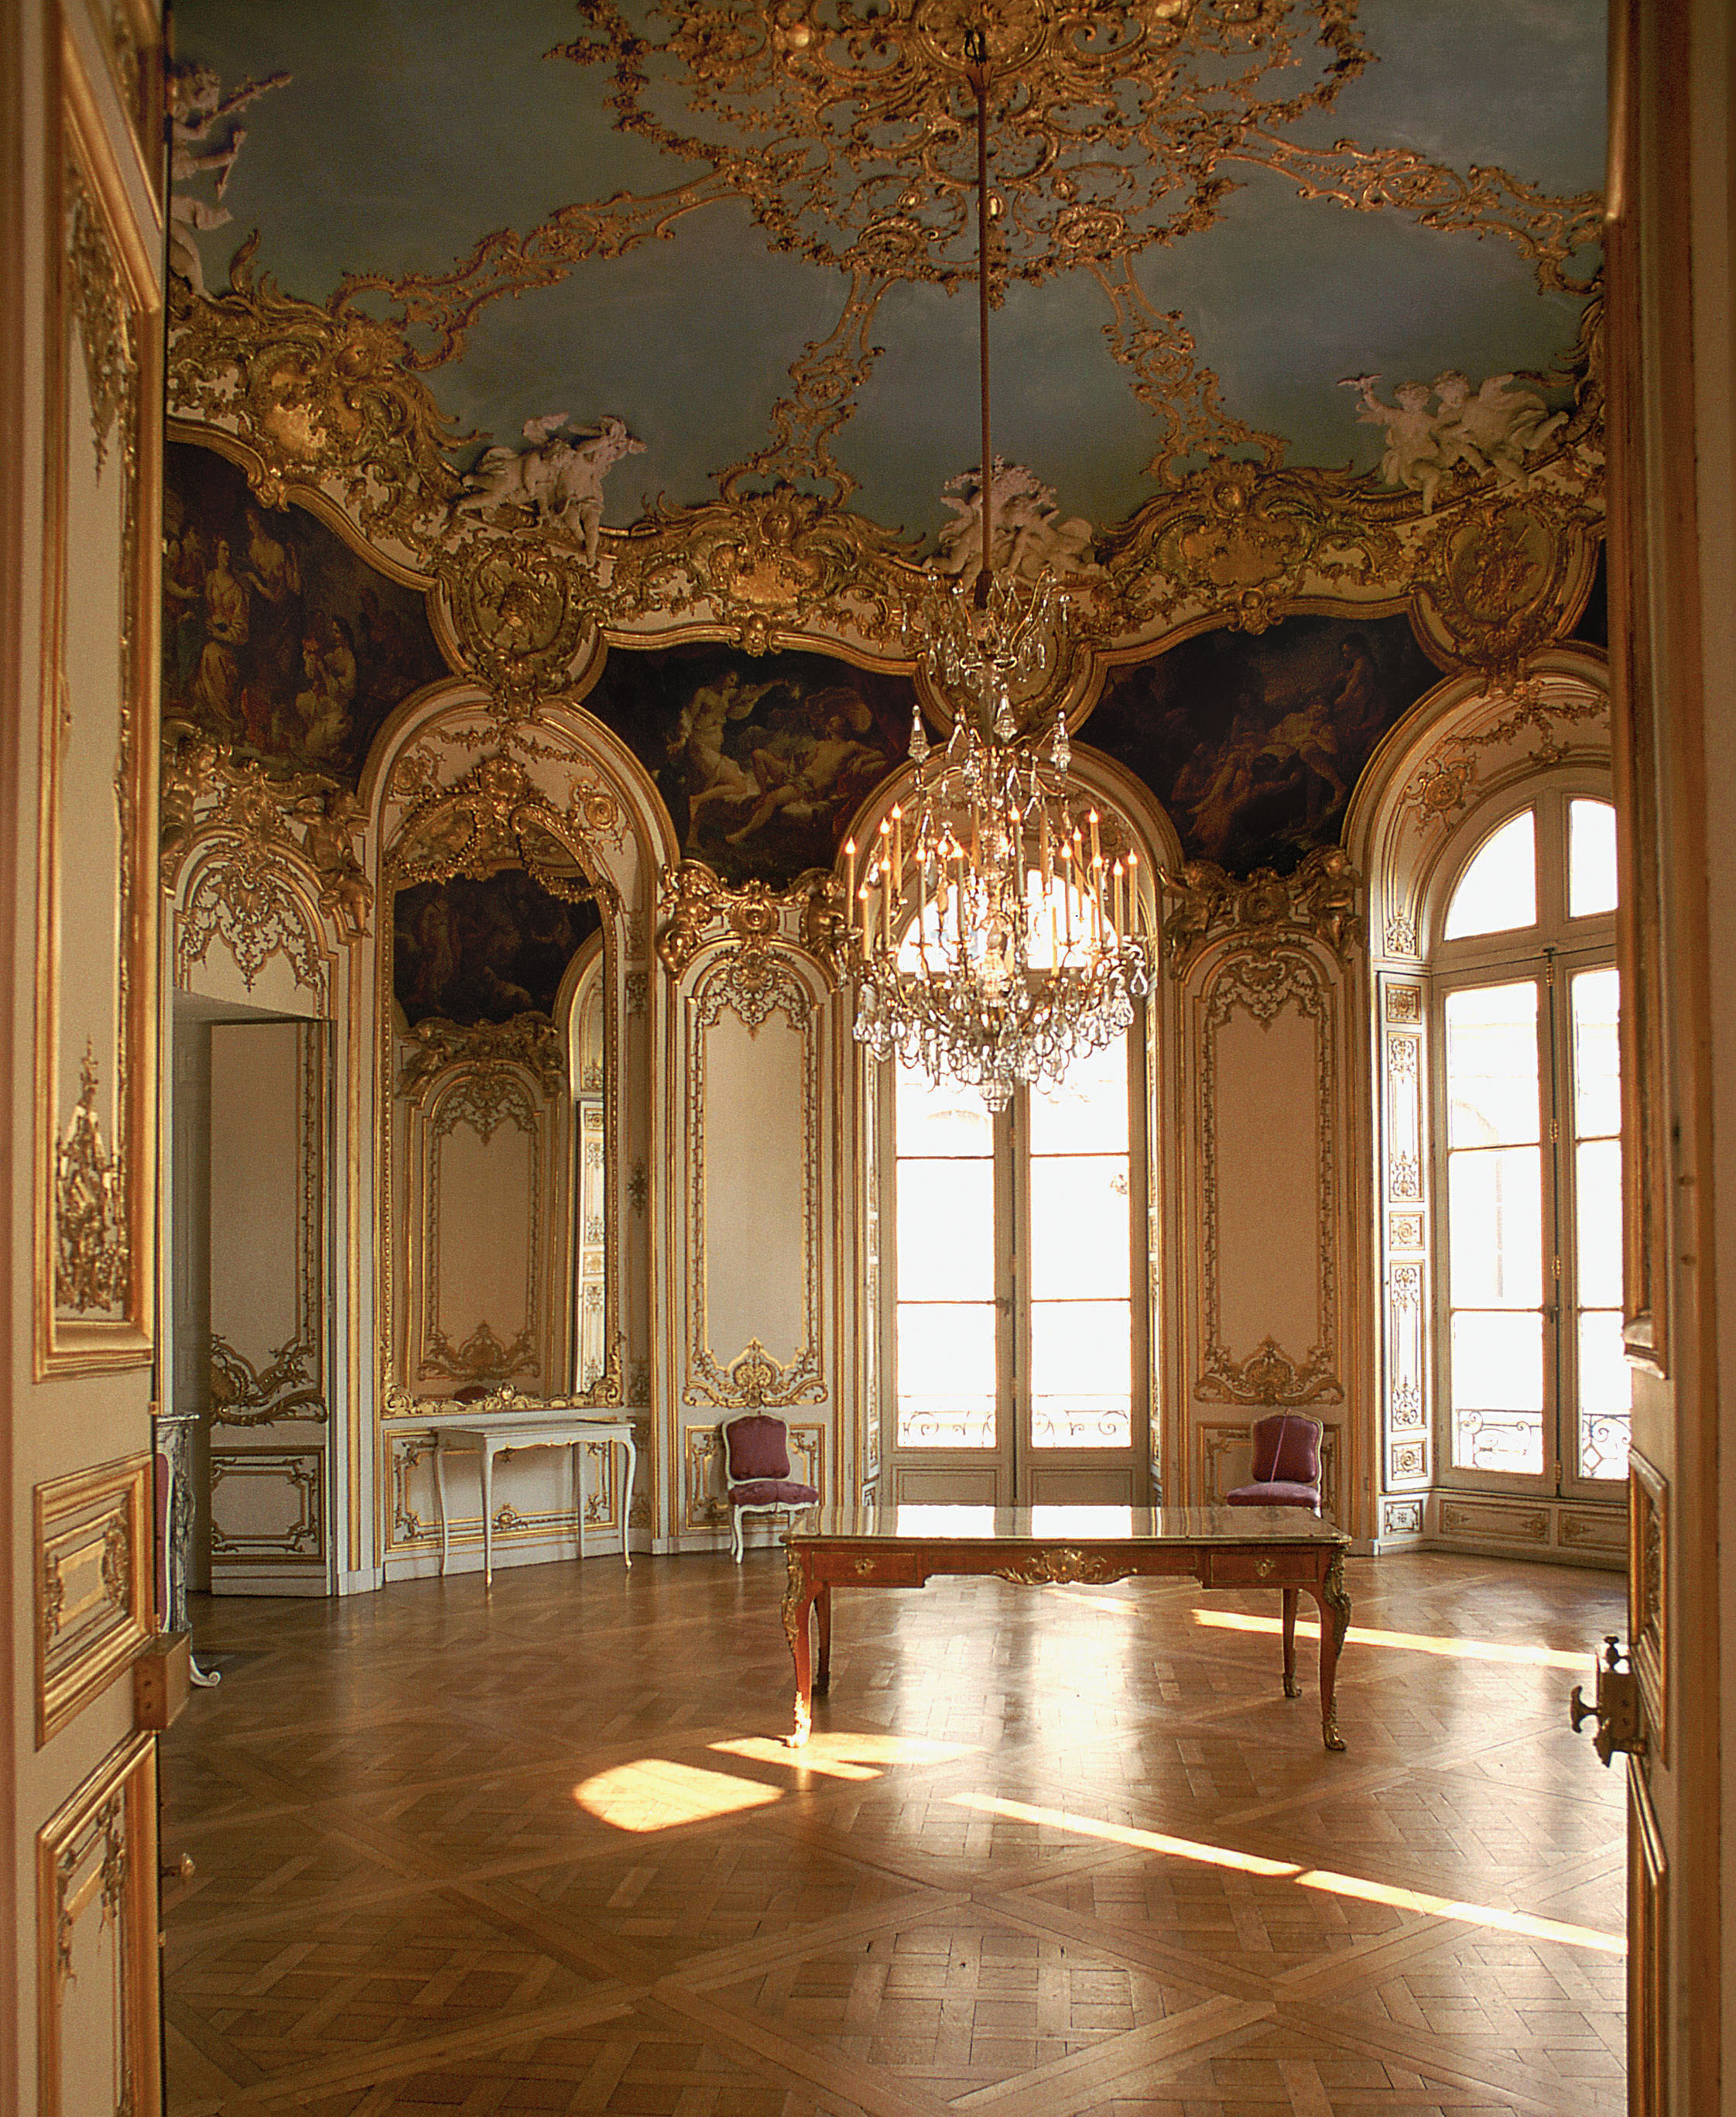
Louis XV, succeeded his great-grandfather, Louis XIV, in 1715 (at age five).
Rococo, from rocaille = pebble
“travail de rocaille”, 1736 first applied to what we now term Rococo interior decoration,
(26-2) Germain Boffrand, Salon de la Princesse, Hotel de Soubise, Paris, 1737-40

Slide 3
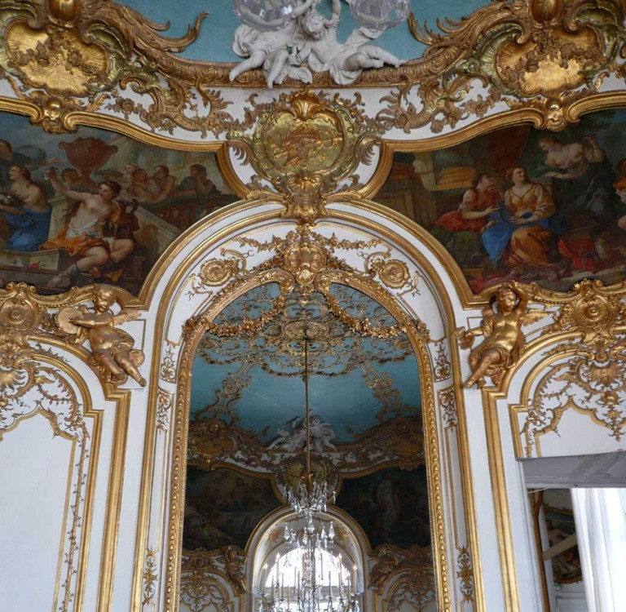
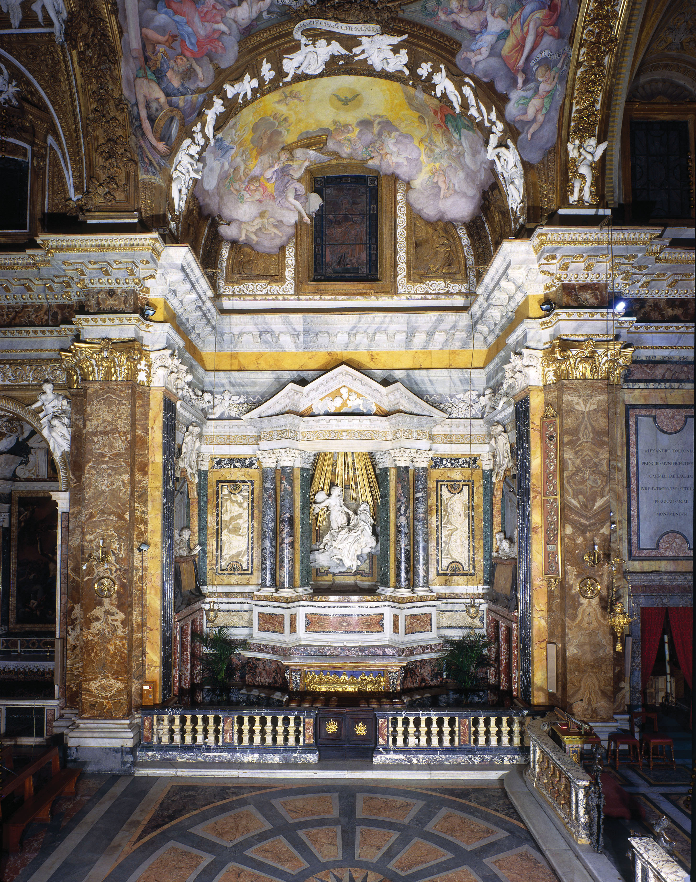

Slide 4
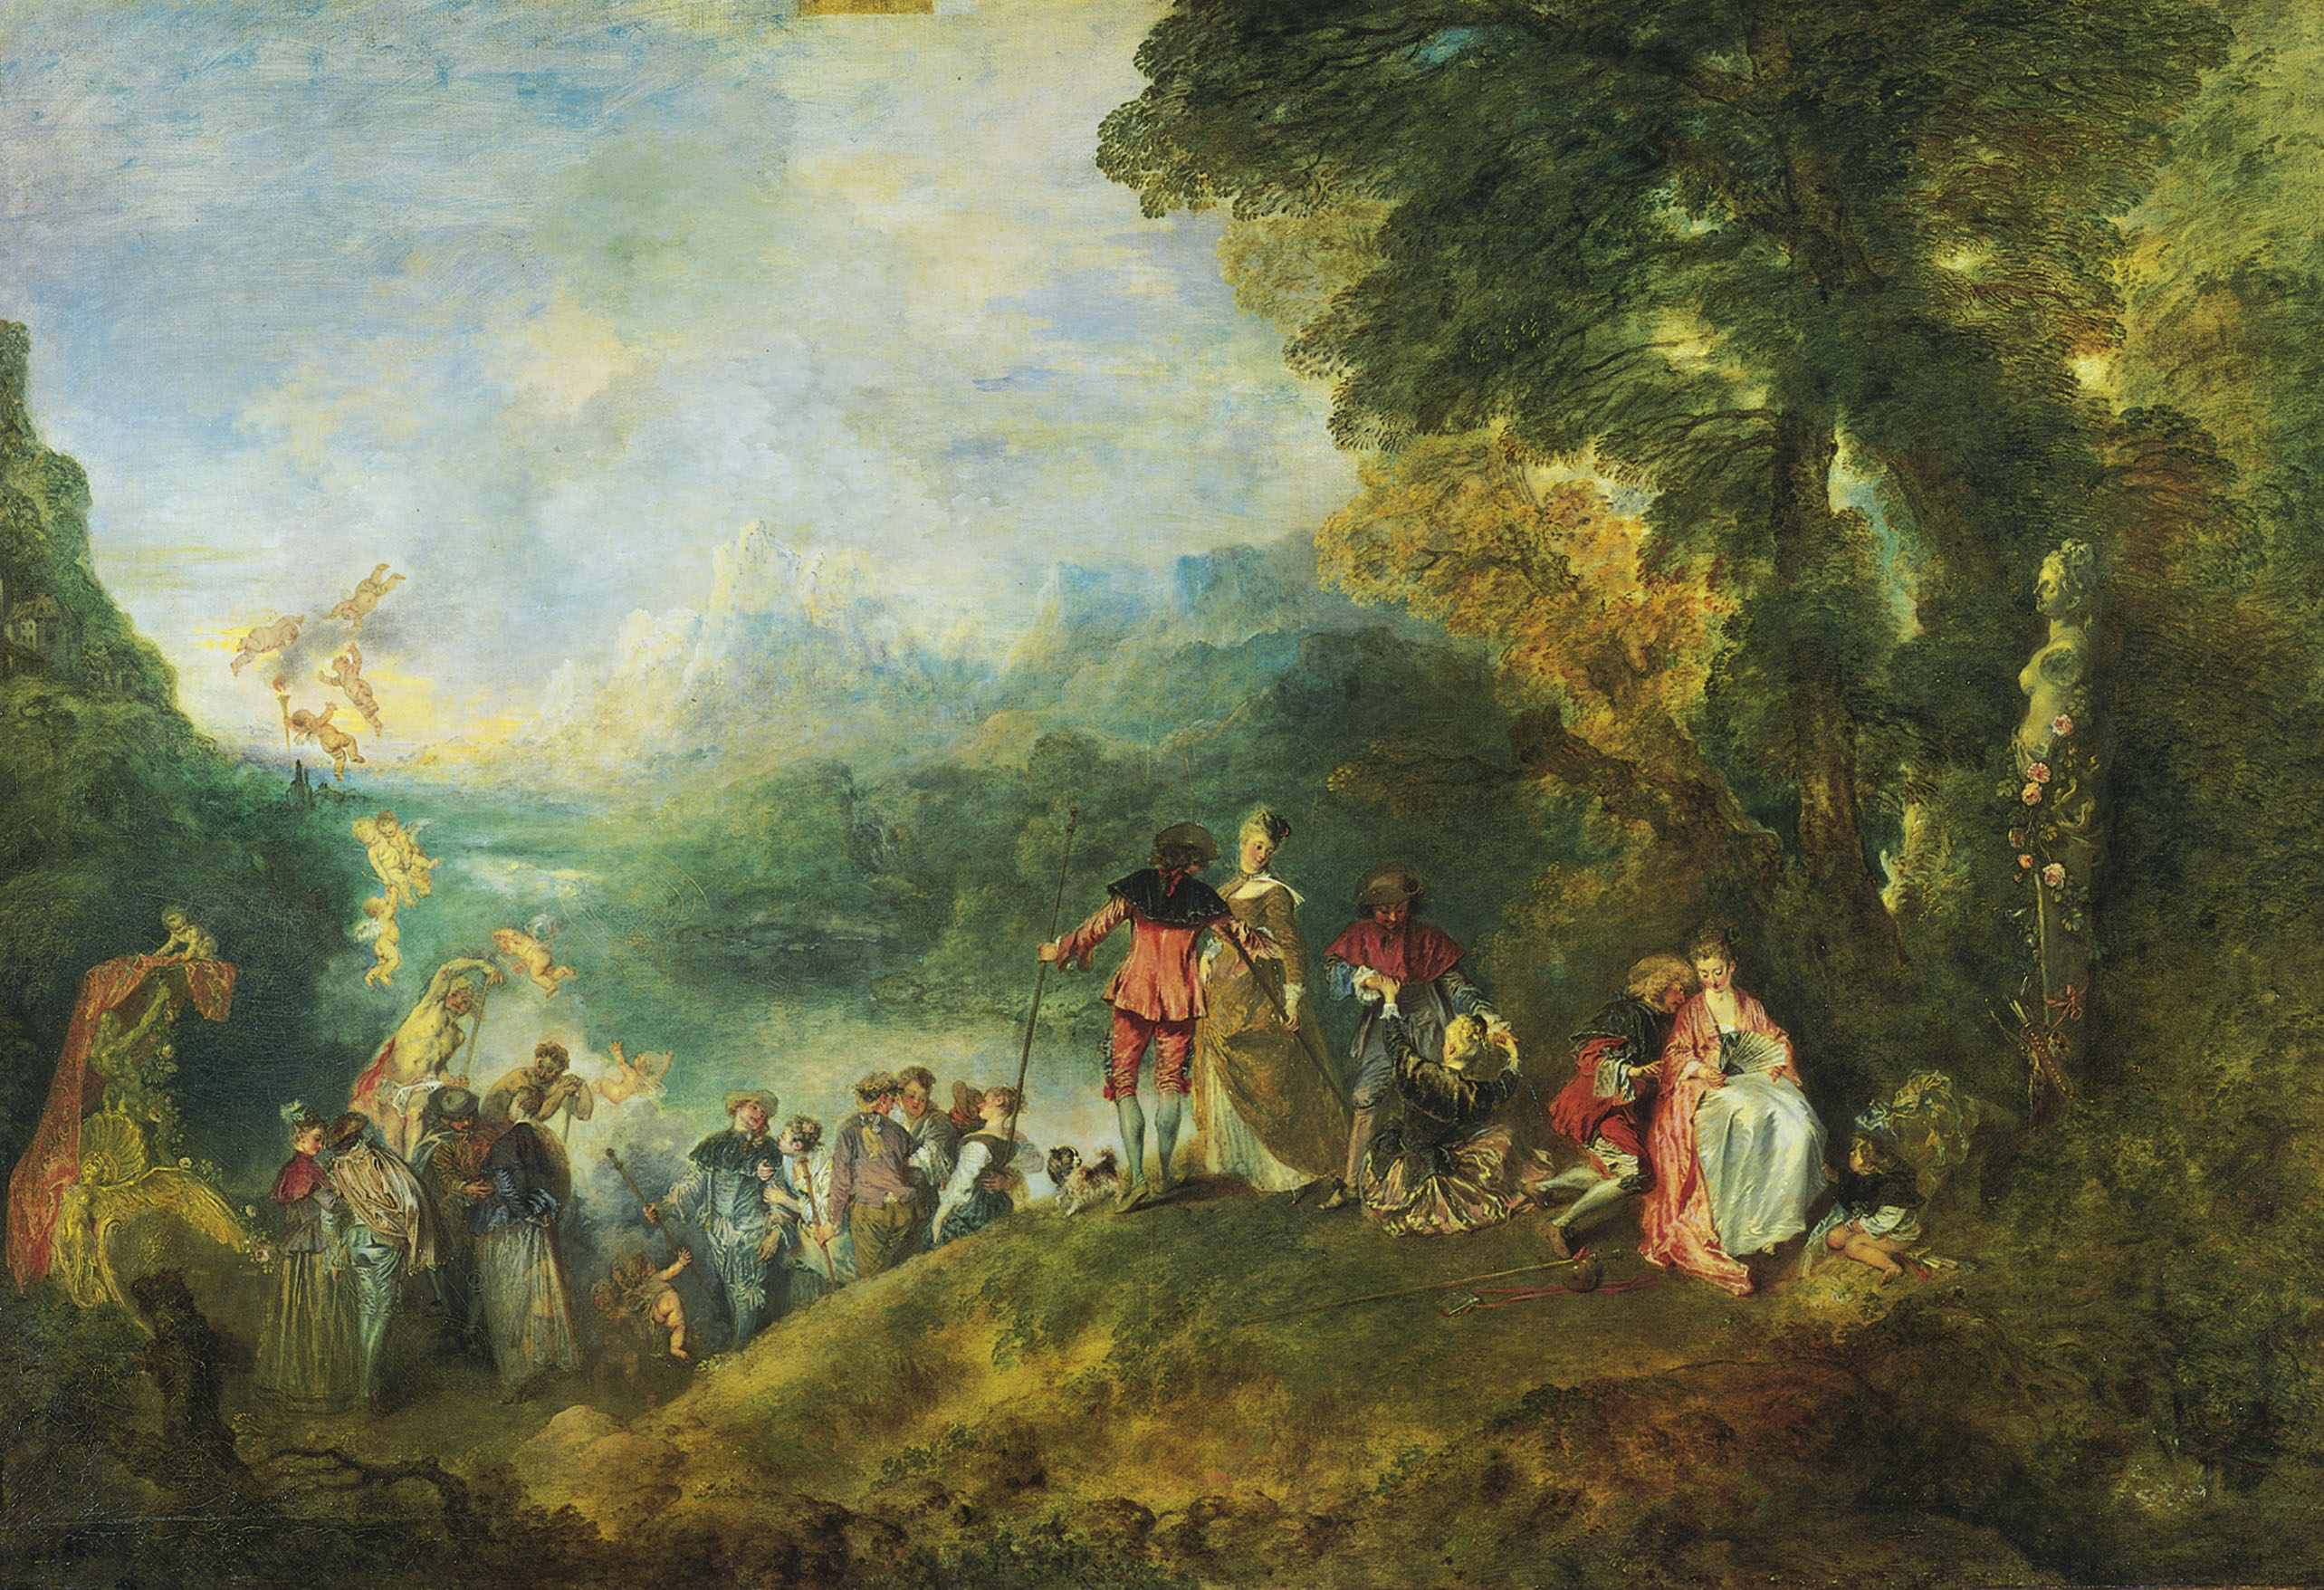
@ (26-7) Antoine Watteau, Pilgrimage to Cythera, 1717

Slide 5
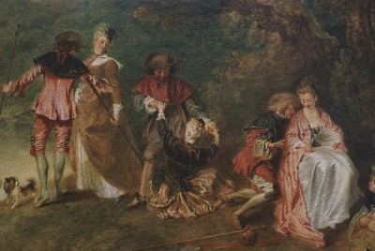
@ (26-7) Antoine Watteau, Pilgrimage to Cythera, 1717

Slide 6
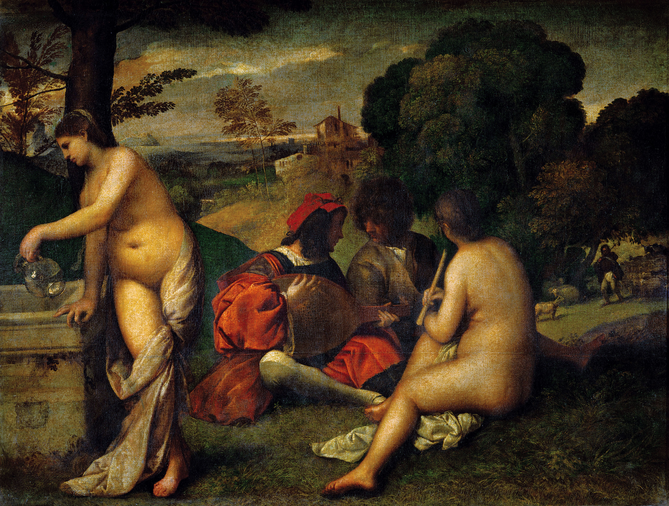
Watteau and the “fête galante”
Debate in the Academie Royale de Peinture et de Sculpture between the Poussinistes and the Rubenistes
Madame de Pompadour, mistress of Louis XV

Slide 7
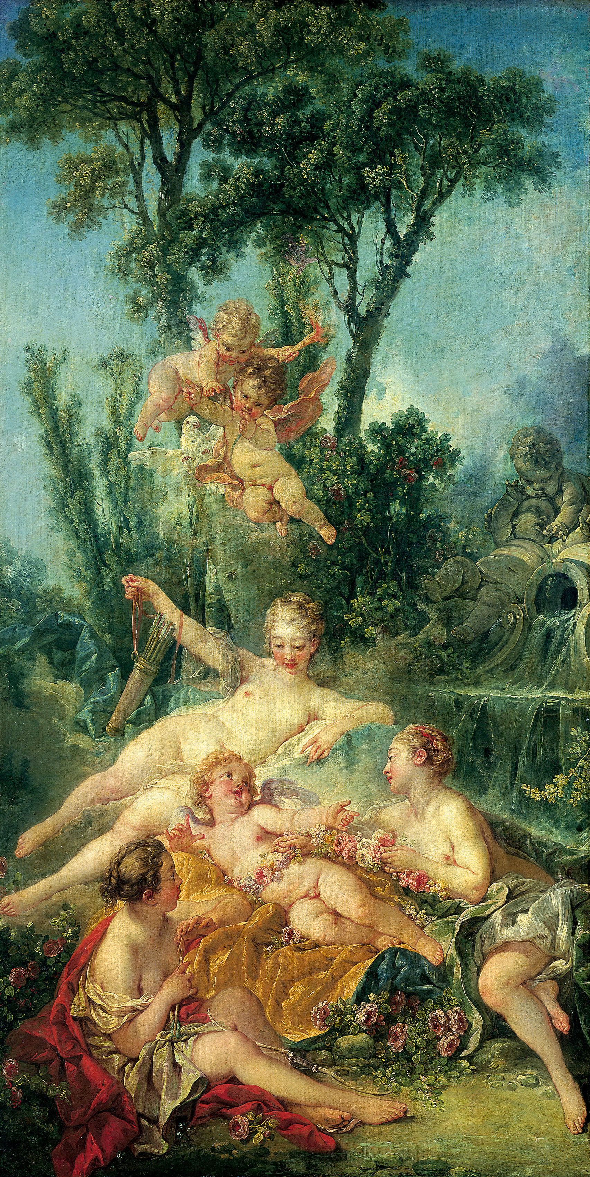
@ (26-8) Francois Boucher, Cupid a Captive, 1754

Slide 8
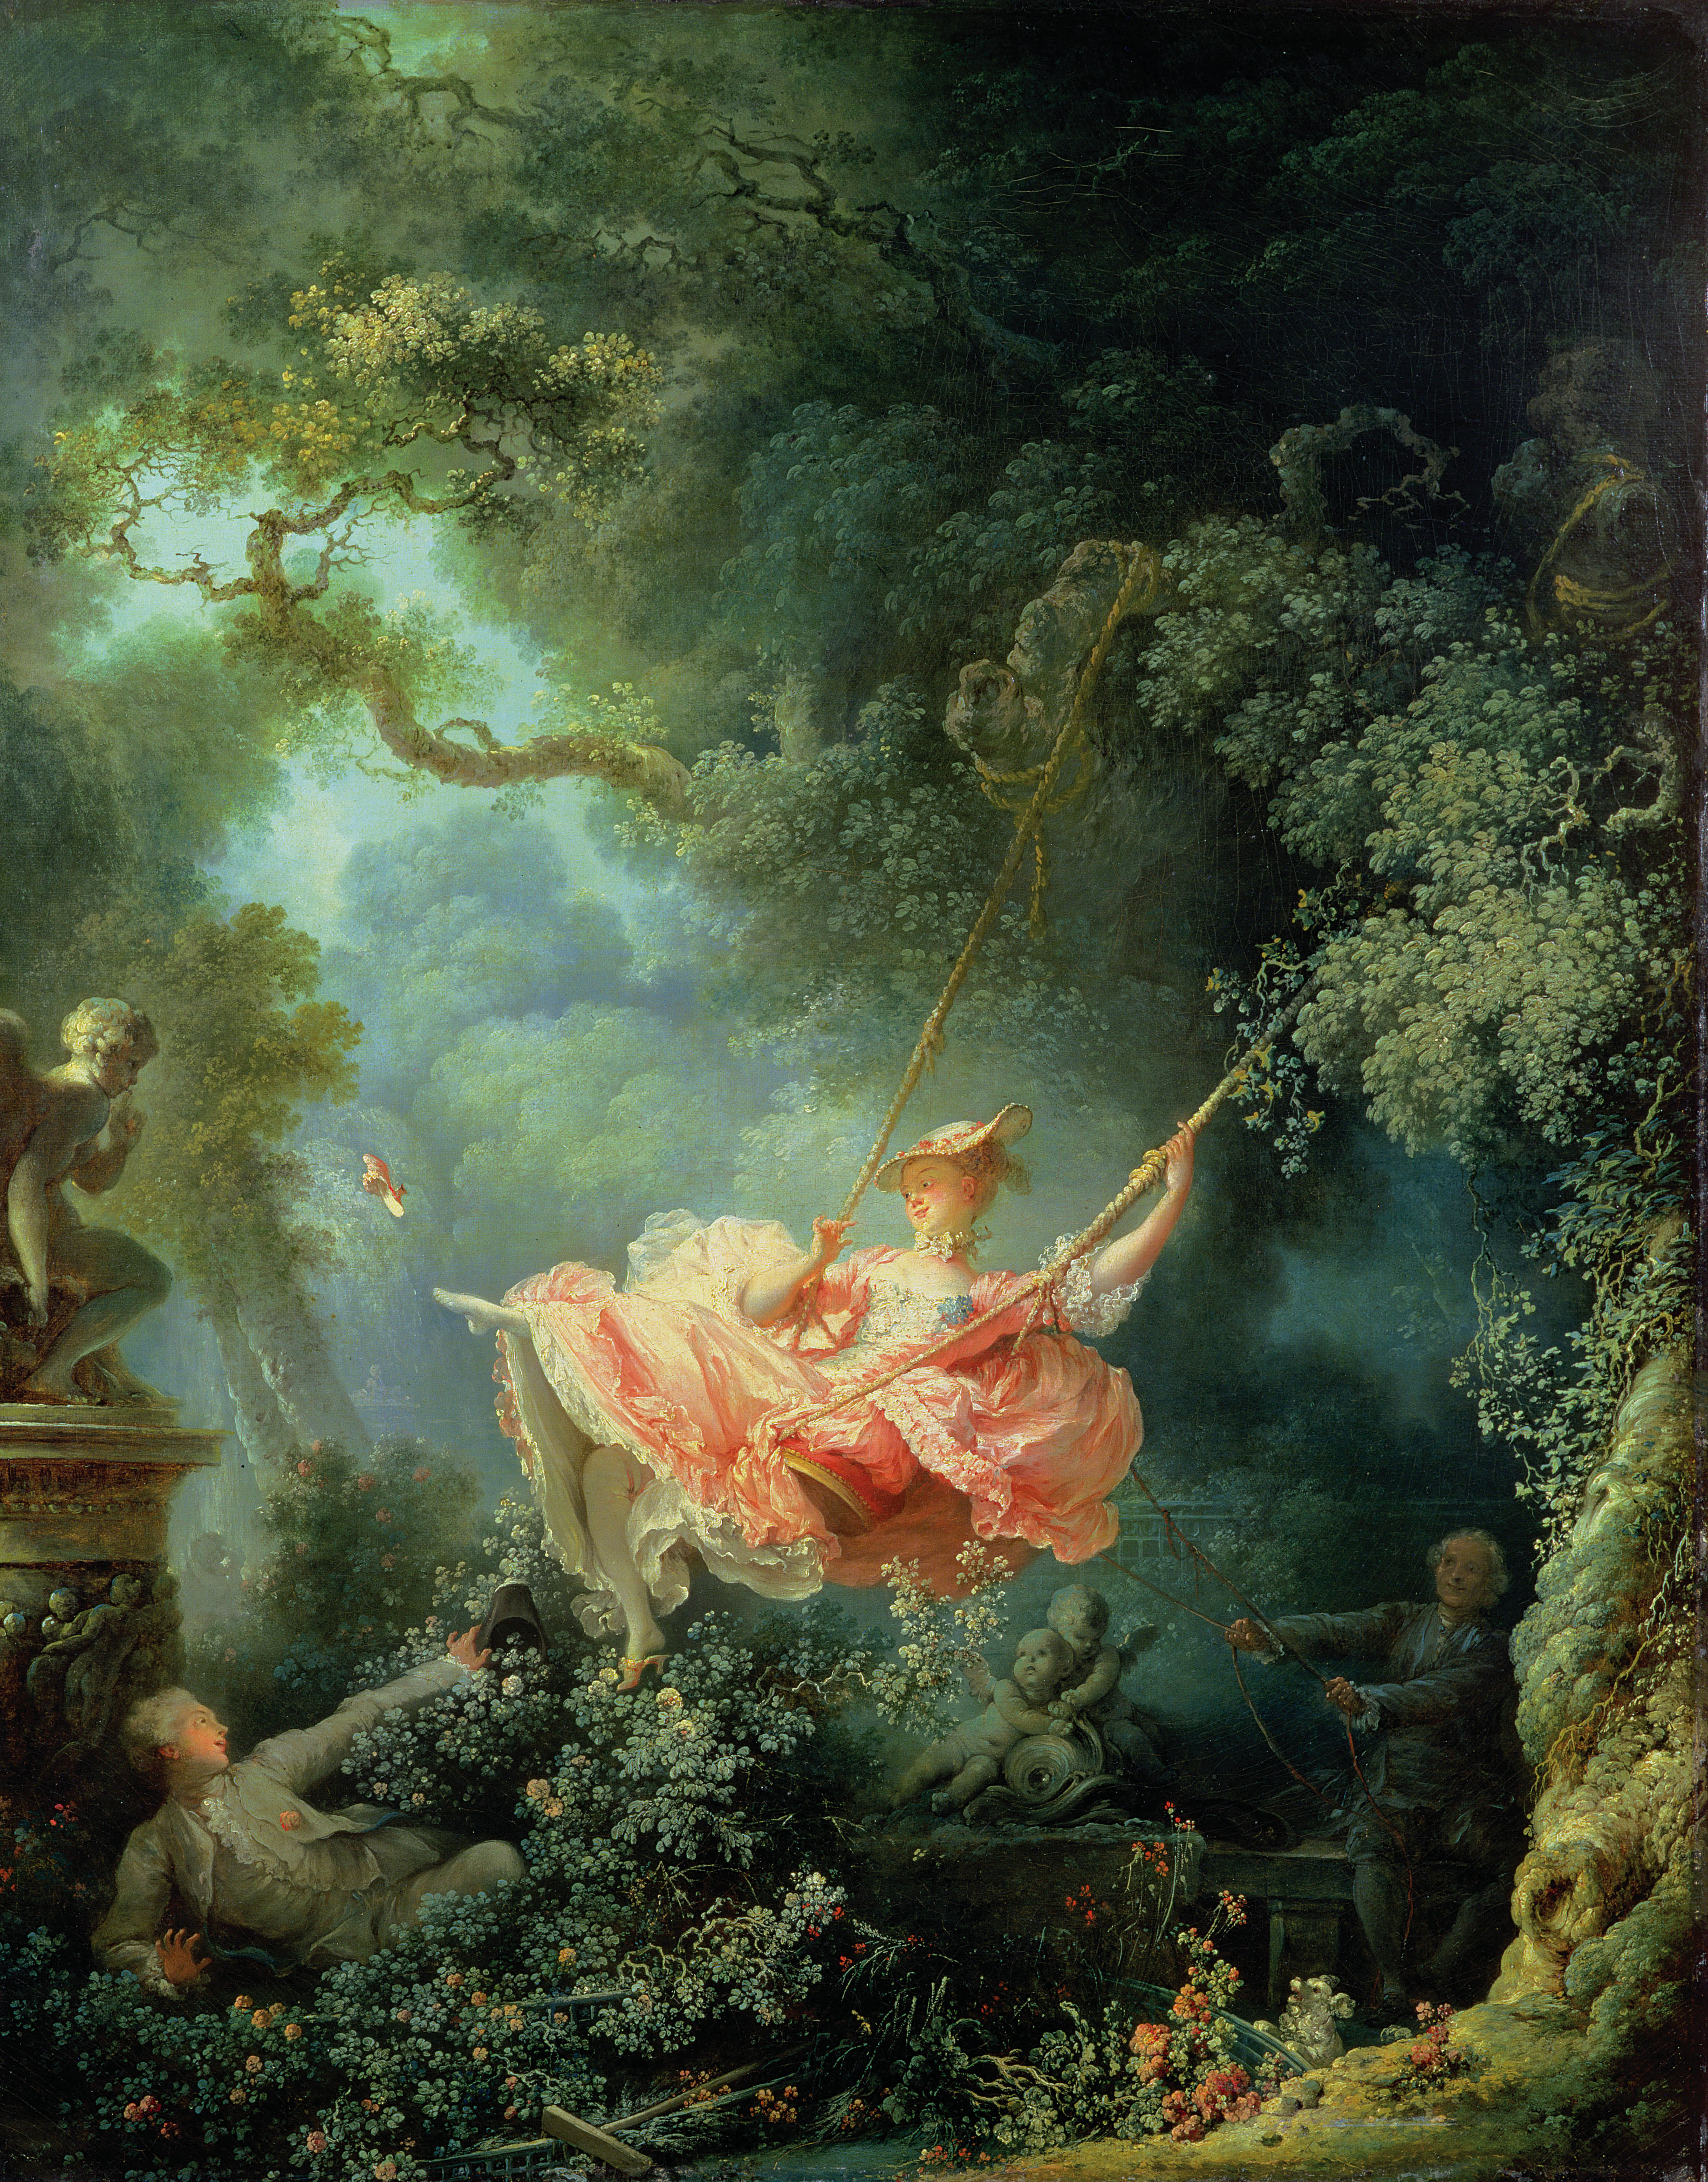
@ (26-8) Francois Boucher, Cupid a Captive, 1754
@ (26-9) Jean-Honore Fragonard, The Swing, 1766

Slide 9
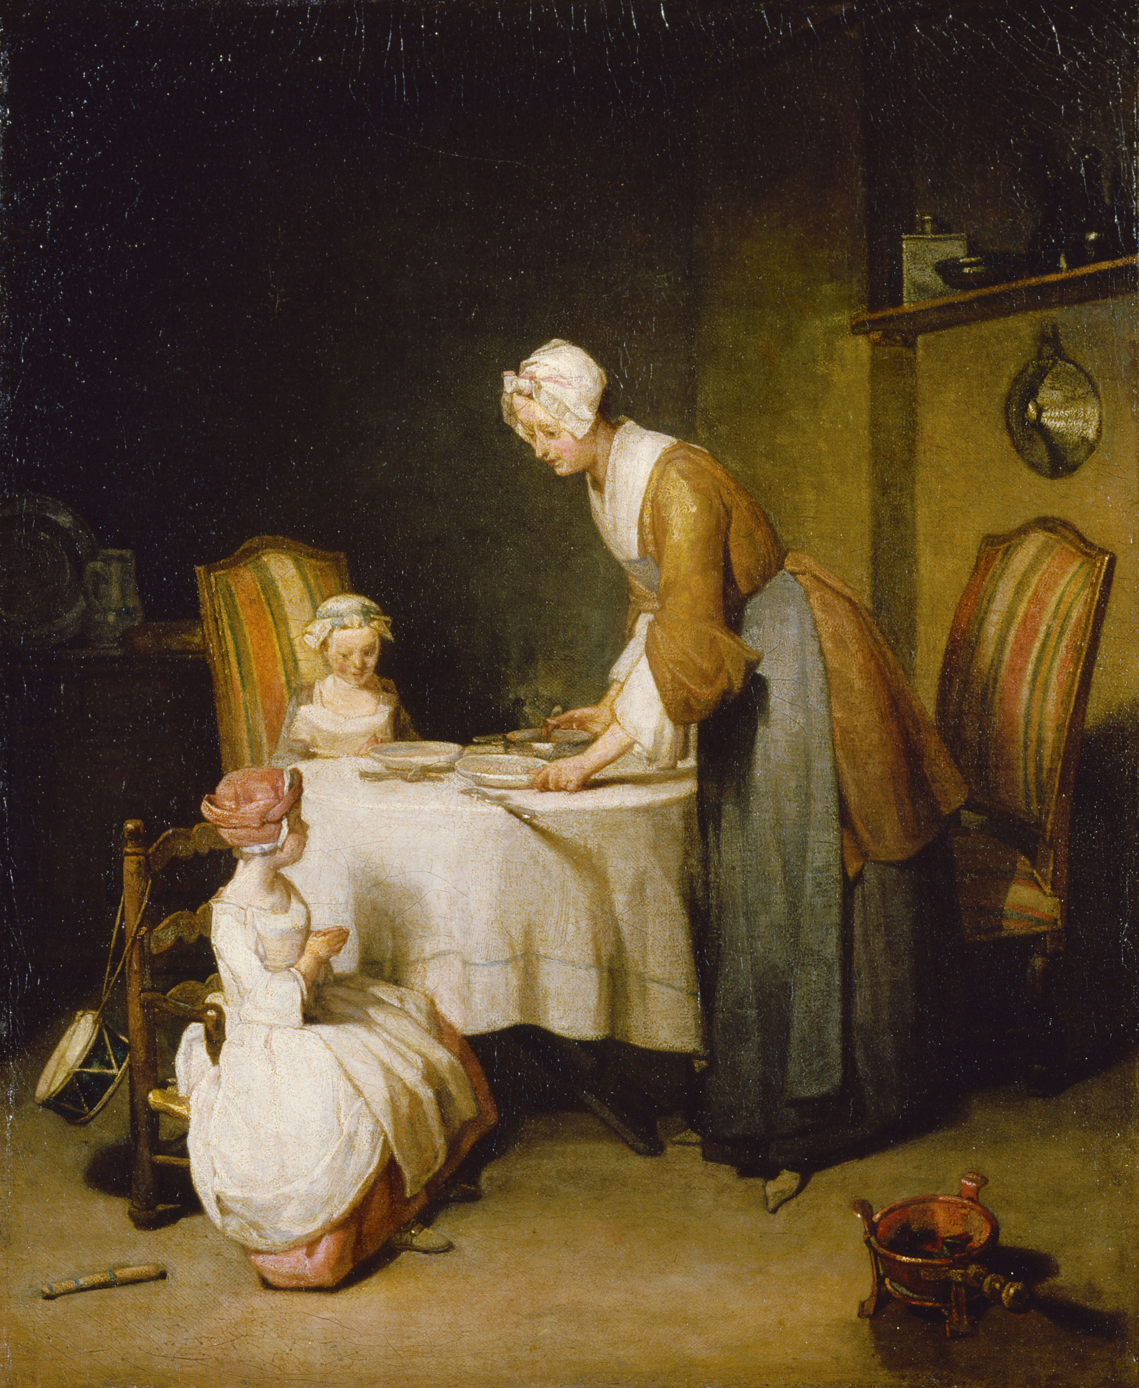
@ (26-14) Jean-Baptiste-Simeon Chardin, Saying Grace, 1740

Slide 10
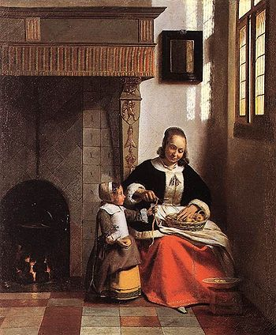
@ (26-14) Jean-Baptiste-Simeon Chardin, Saying Grace, 1740
Pieter de Hooch, Woman Peeling Apples and Child, 1663

Slide 11
The French Enlightenment
Denis Diderot, Voltaire
Diderot on Boucher in the Salon of 1765: “I do not know what to say of this man. Degradation of taste, of color, of composition, of character, follow upon deprivation of morals. What can there be in the imagination of a man who passes his life with loose women of the lower classes?”
Jean Jacques Rousseau: “Man by nature is good…he is depraved and perverted by society”… “Our minds have been corrupted in proportion as the arts and sciences have been improved”… “To exist is to feel.”
(26-14) Jean-Baptiste-Simeon Chardin, Saying Grace, 1740

Slide 12
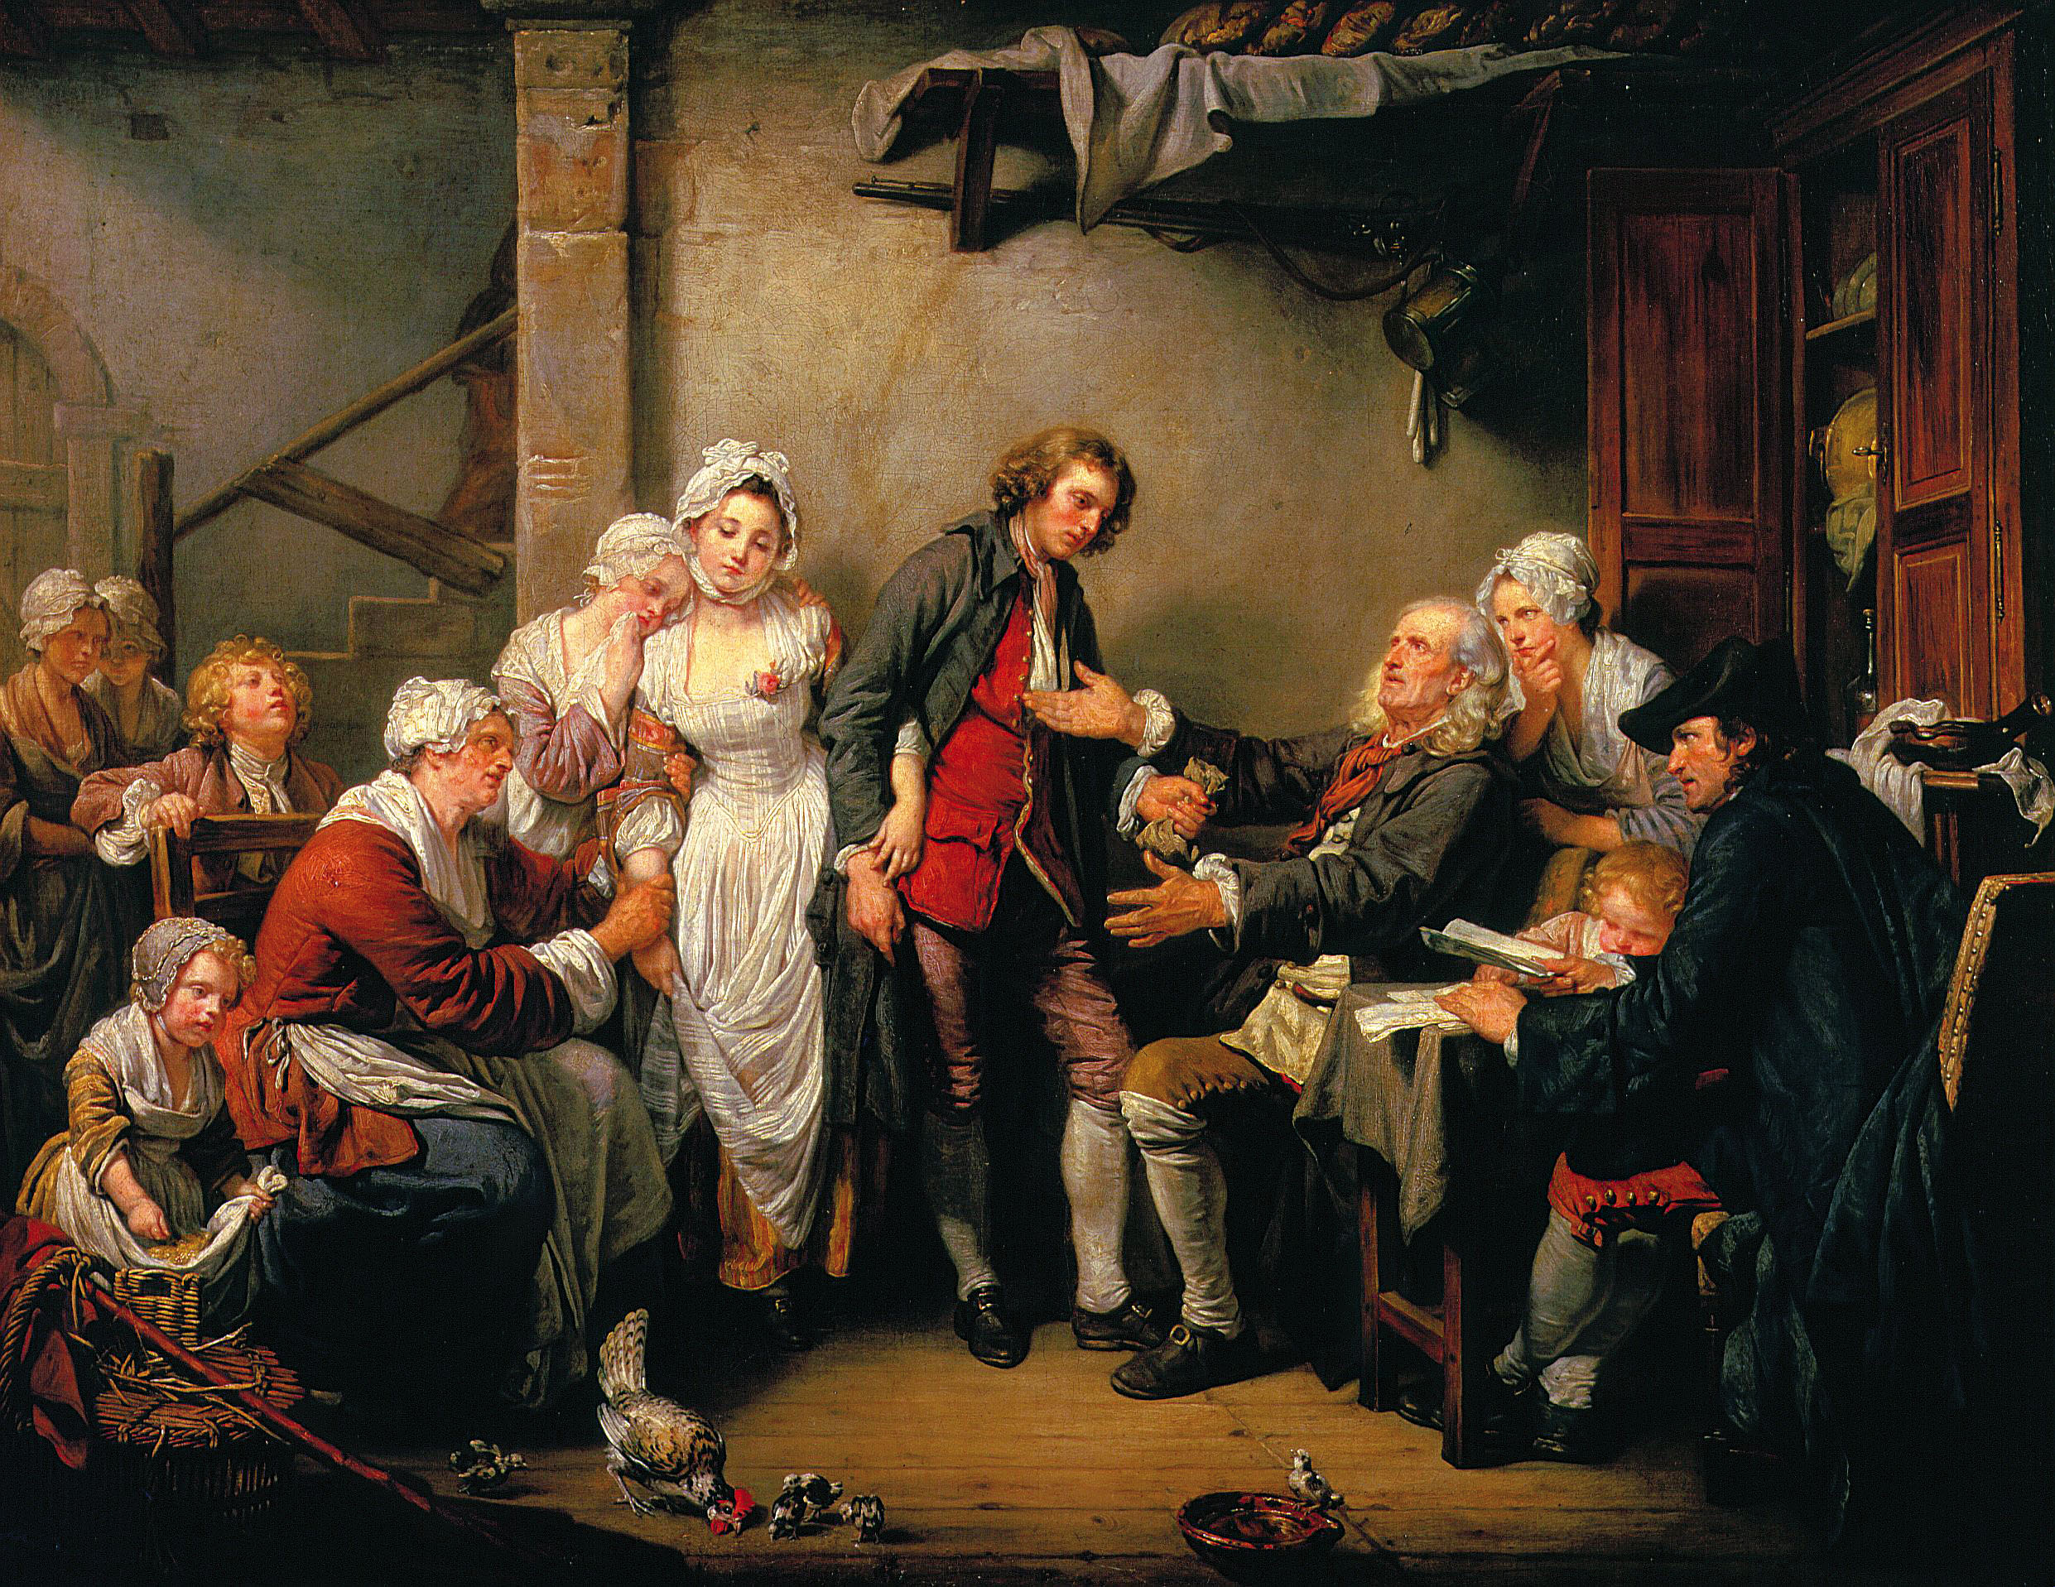
@ (26-15) Jean-Baptiste Greuze, The Village Bride, 1761

Slide 13
Diderot on Greuze’s Village Bride: “sweet emotion…decency and reverence, and a charming innocence…His work is full of understanding and delicacy. His choice of subjects is a mark of sensibility and morality.”
@ (26-15) Jean-Baptiste Greuze, The Village Bride, 1761

Slide 14
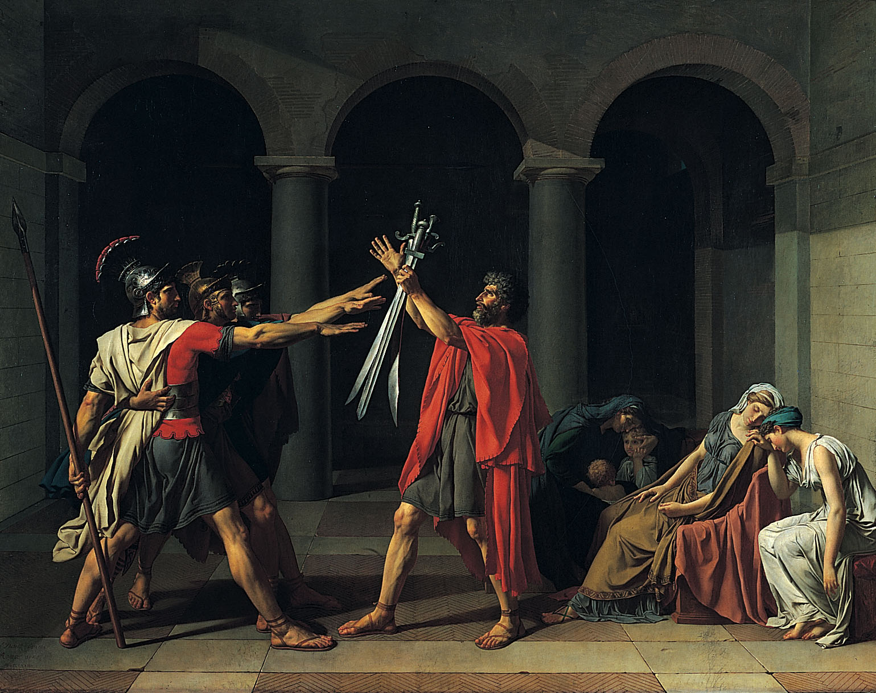
@ (26-26) Jacques-Louis David, Oath of the Horatii, 1784

Slide 17
(26-26) Jacques-Louis David, Oath of the Horatii, 1784

Slide 18
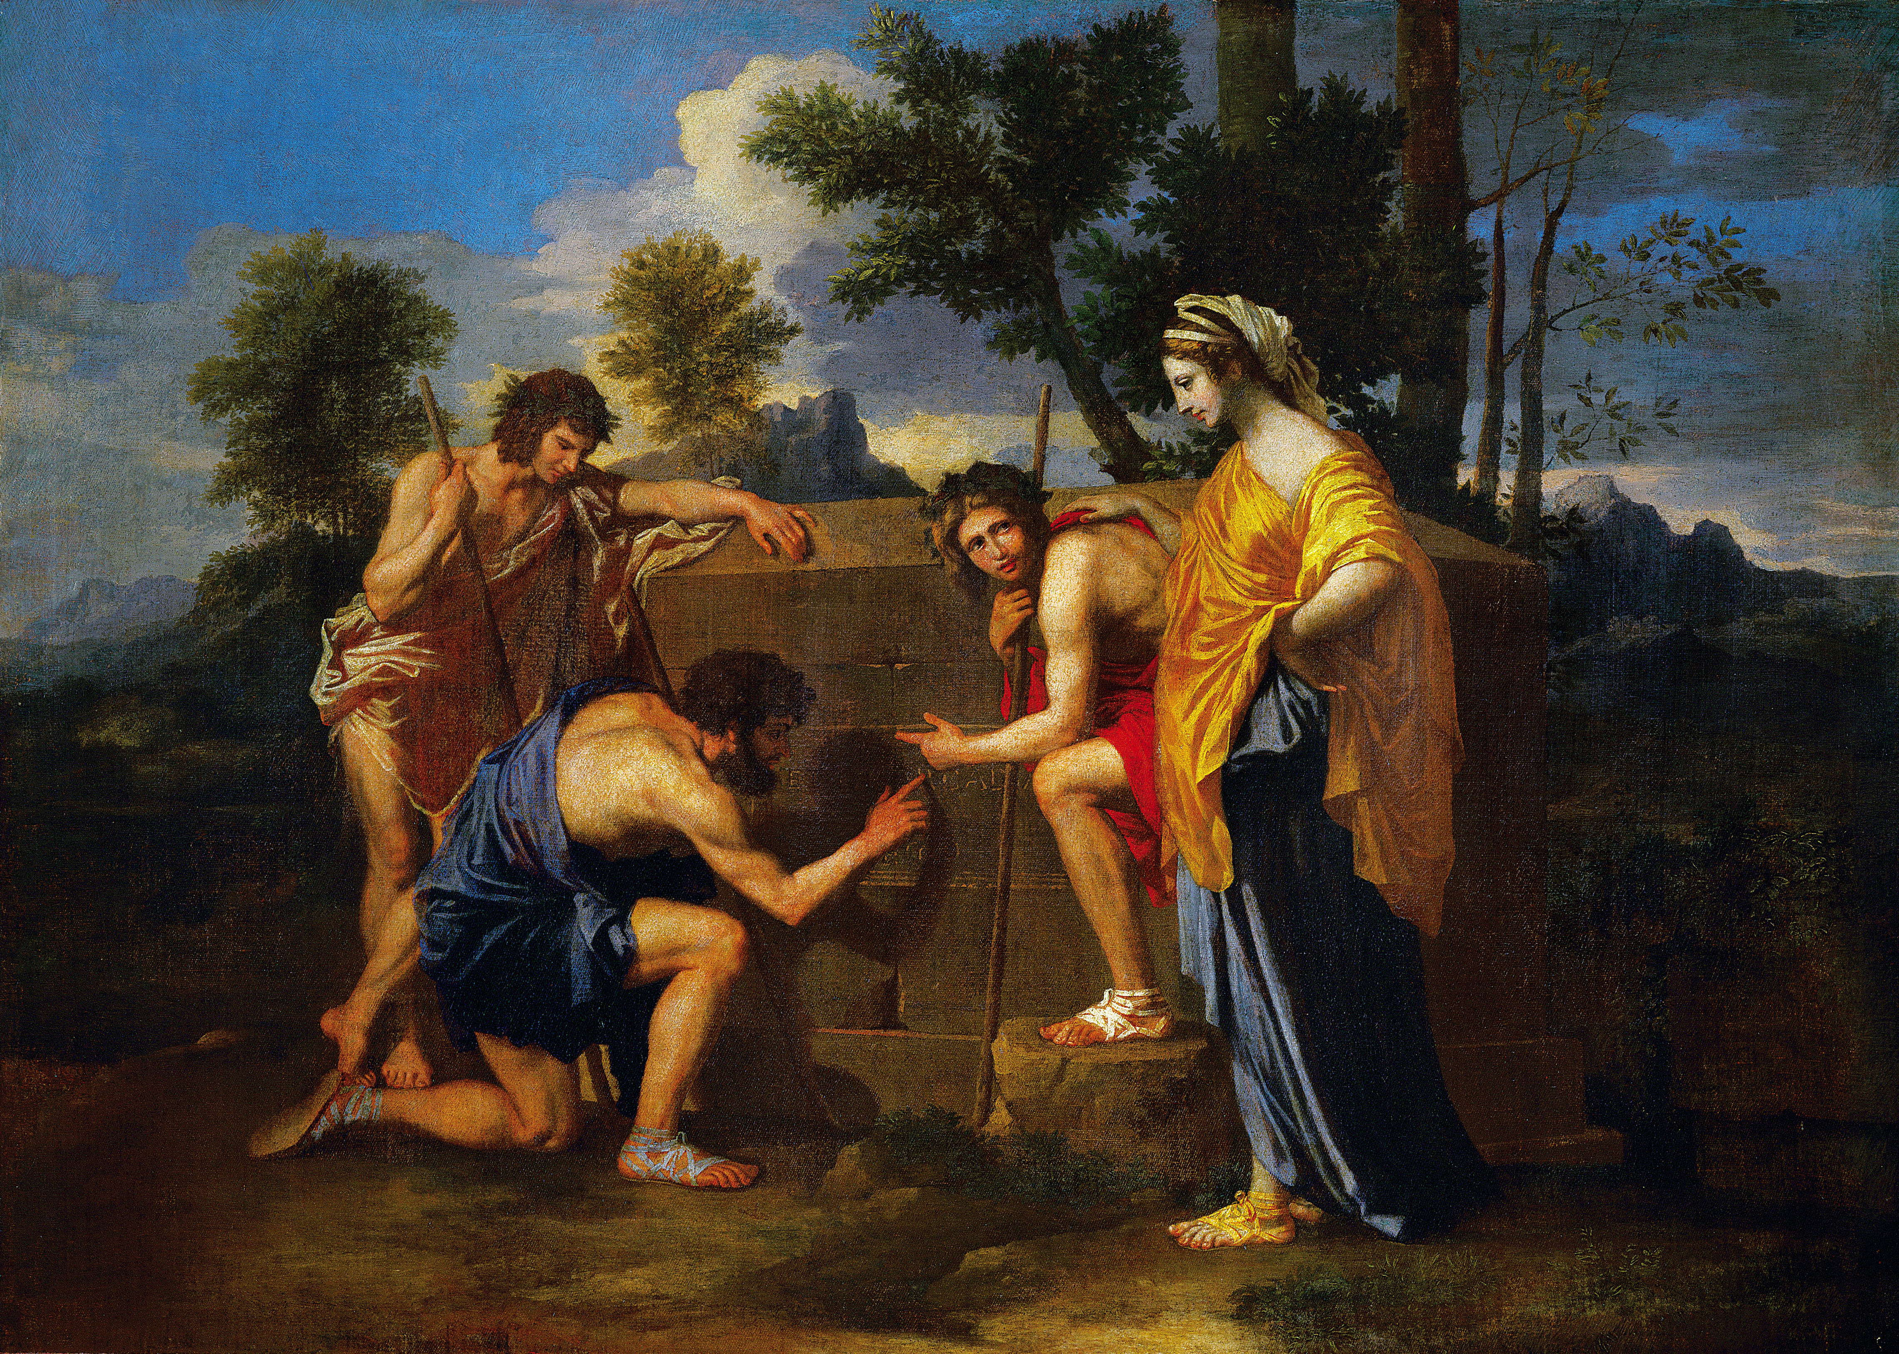
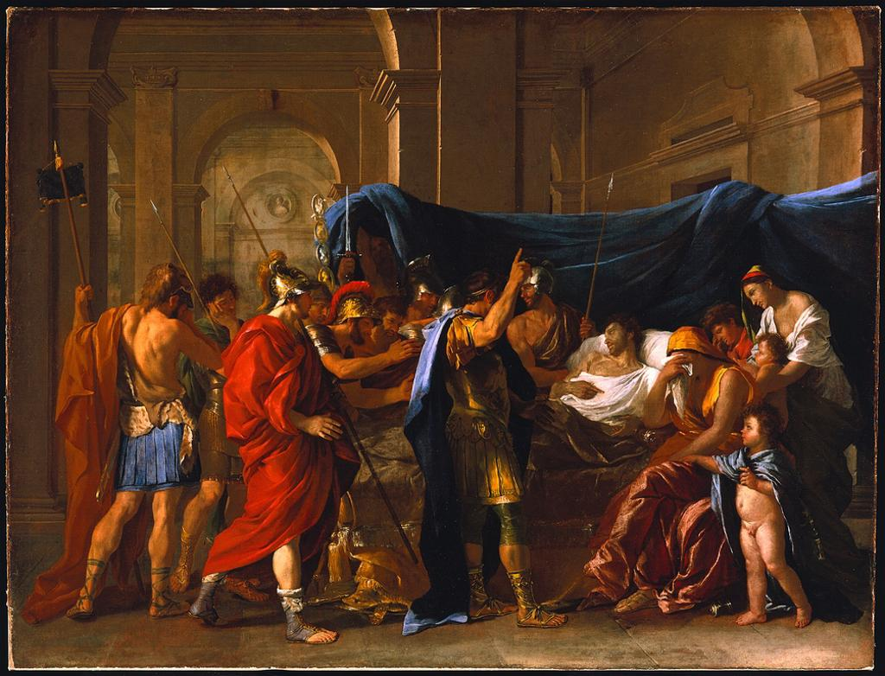
Nicolas Poussin, Death of Germanicus, 1627
@ (26-26) Jacques-Louis David, Oath of the Horatii, 1784

Slide 19
Jacques Louis David: “I want to work in a pure Greek style. I feed my eyes on ancient statues.”

Slide 20
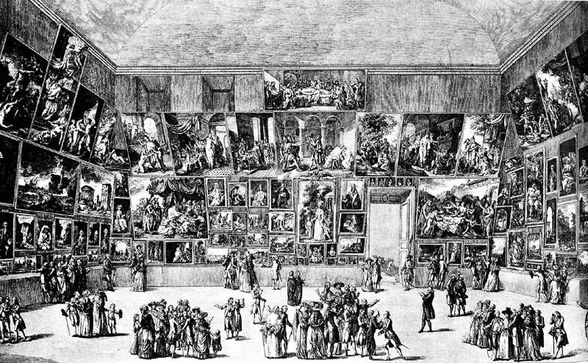
Engraved view of Salon of 1787 with David’s Oath of the Horatii visible

Slide 21
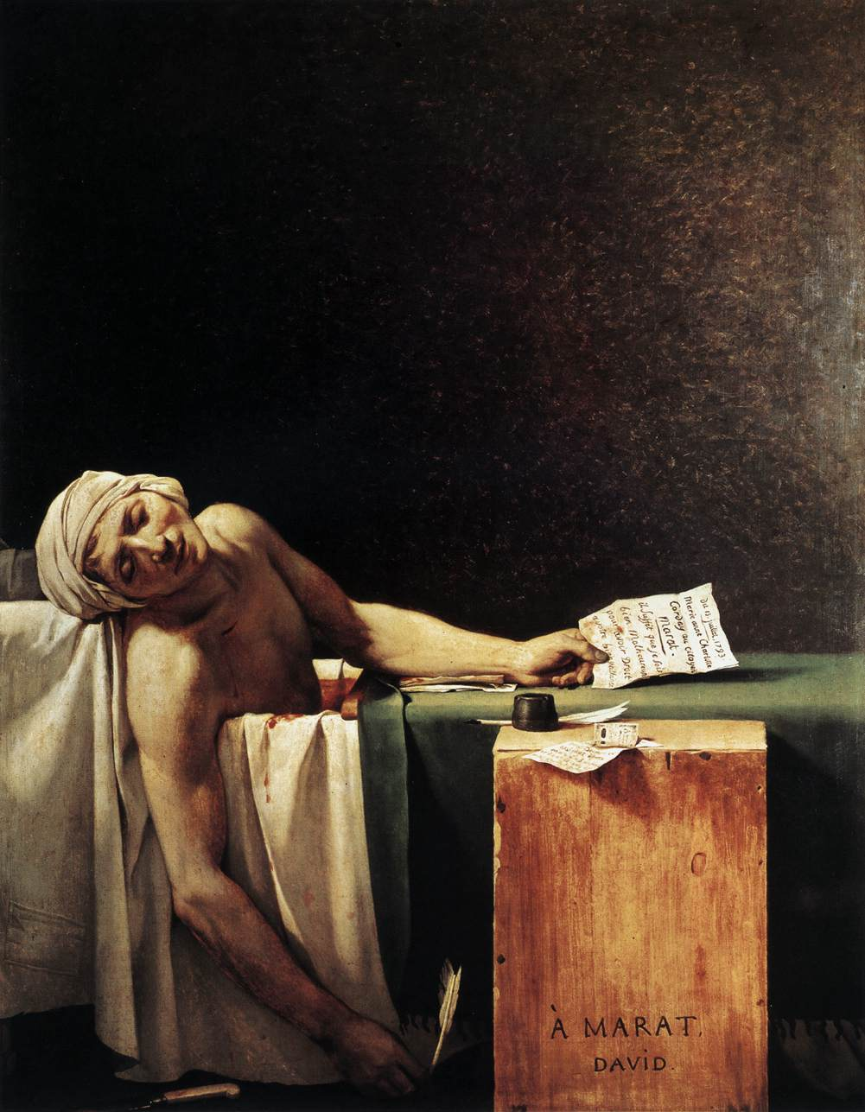
(26-27) Jacques-Louis David, Death of Jean-Paul Marat, 1793

Slide 22
Jacques Louis David (1793): “[The arts] should help to spread the progress of the human spirit, and to propagate and transmit to posterity the striking examples of the efforts of a tremendous people who, guided by reason and philosophy, are bringing back to earth the reign of liberty, equality, and law…Those marks of heroism and civic virtue offered the eyes of the people will electrify its soul, and plant the seeds of glory and devotion to the fatherland.”
(26-27) Jacques-Louis David, Death of Jean-Paul Marat, 1793

